Slide 1
TAS
NF/KG

Slide 2
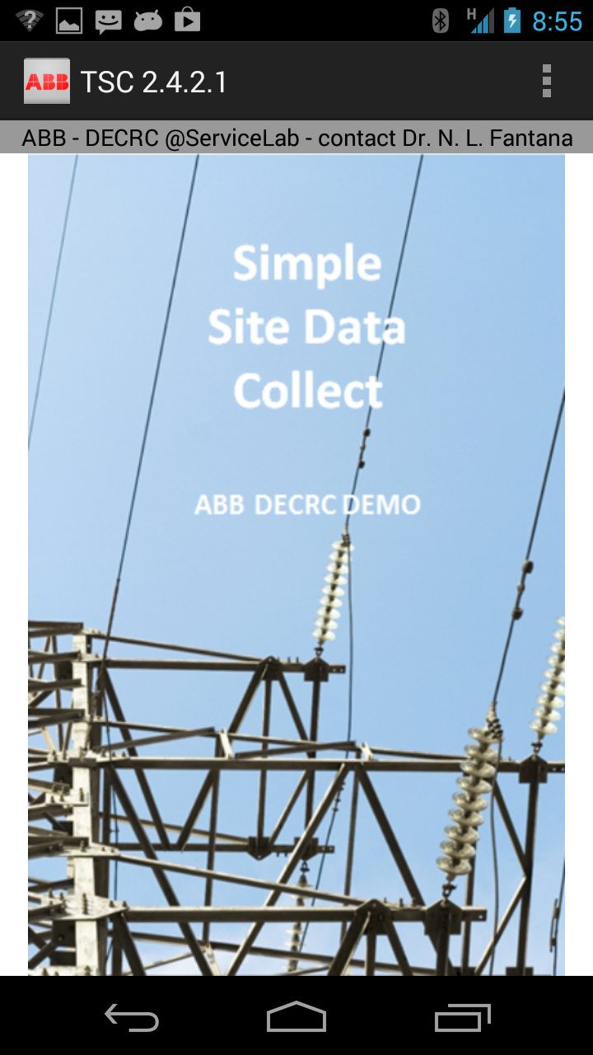
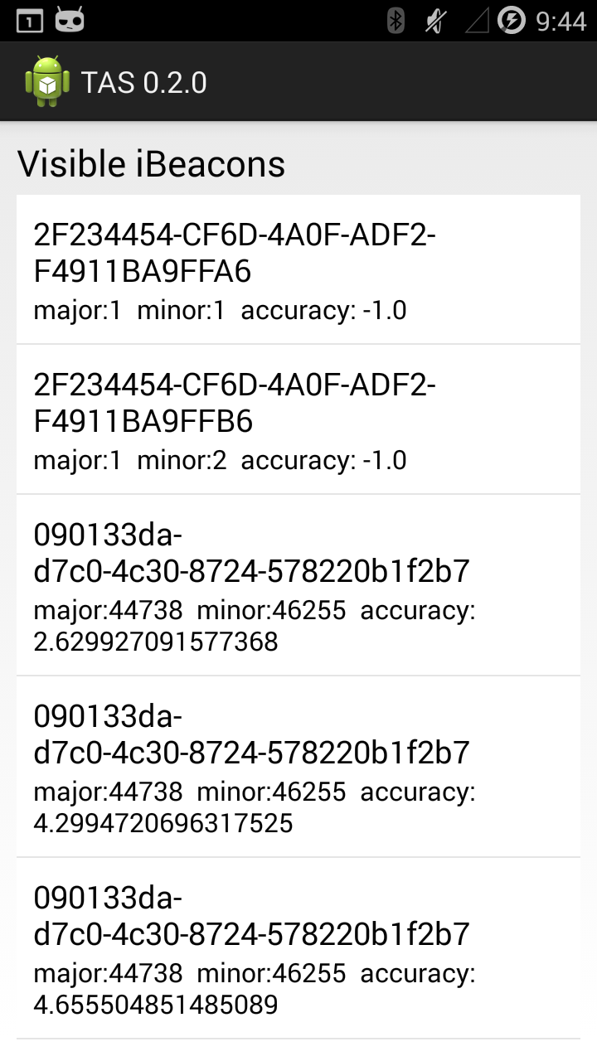
TAS 0.2.0

Slide 3
TAS 0.2.0
Features
Show found iBeacons in ListView

Slide 4
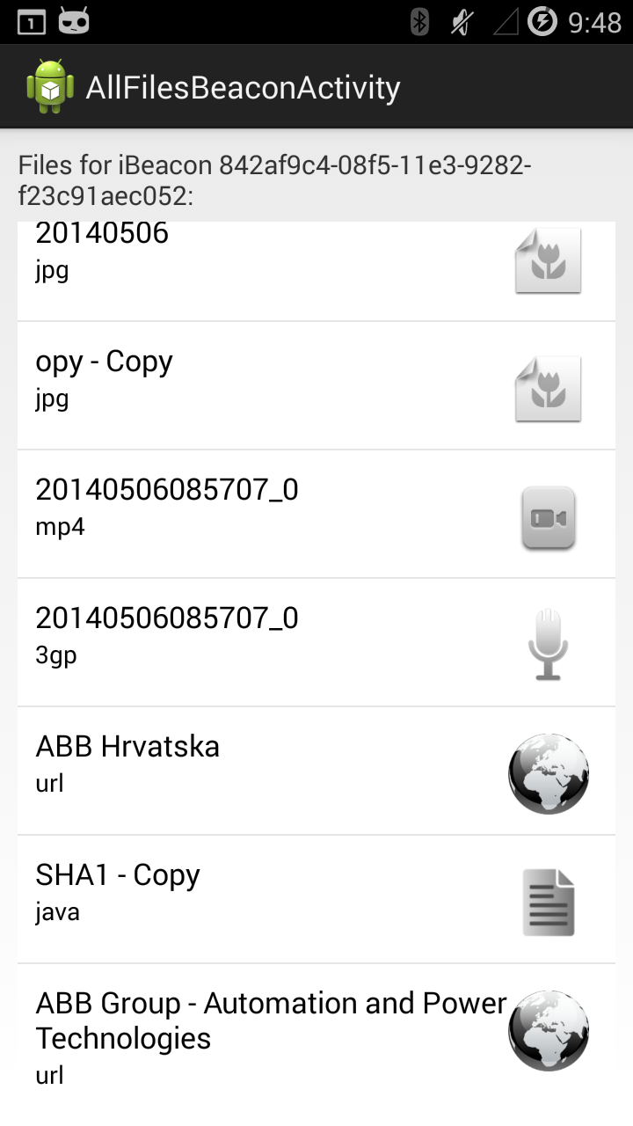
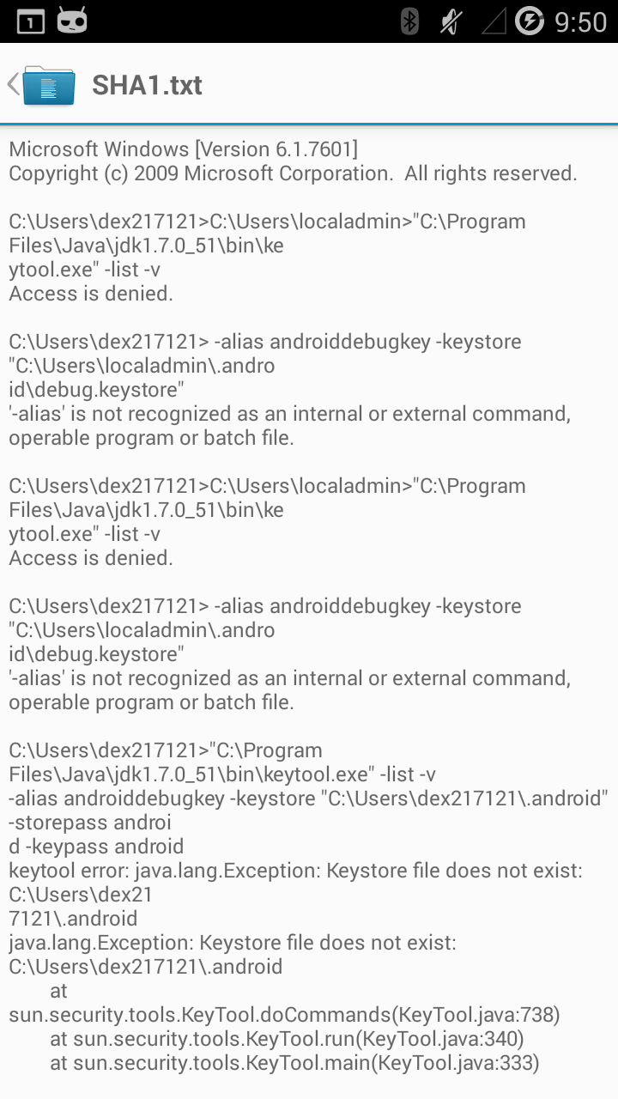
TAS 0.3.0

Slide 5
TAS 0.3.0
Features
Show found iBeacons in ListView
Show all files of iBeacon
Show content of files

Slide 6
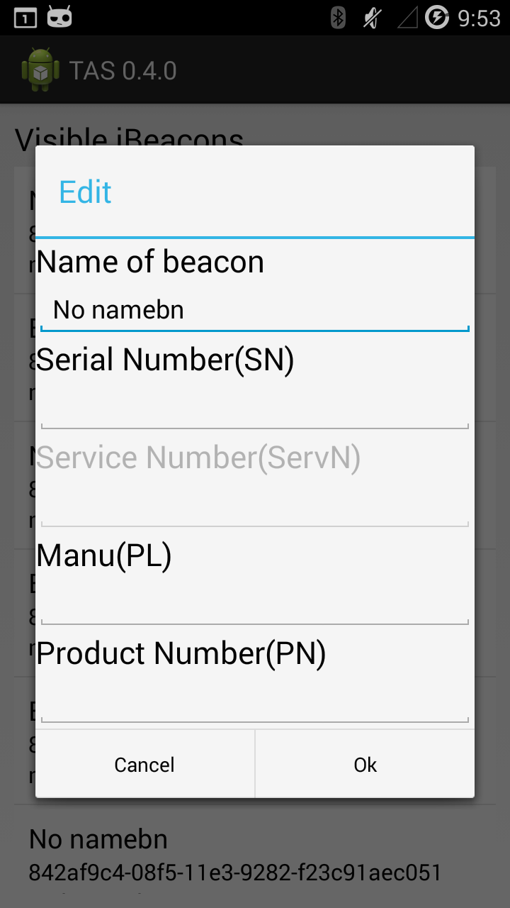
TAS 0.4.0

Slide 7
TAS 0.4.0
Features
Show found iBeacons in ListView
Show all files of iBeacon
Show content of files
Change name of iBeacon

Slide 8
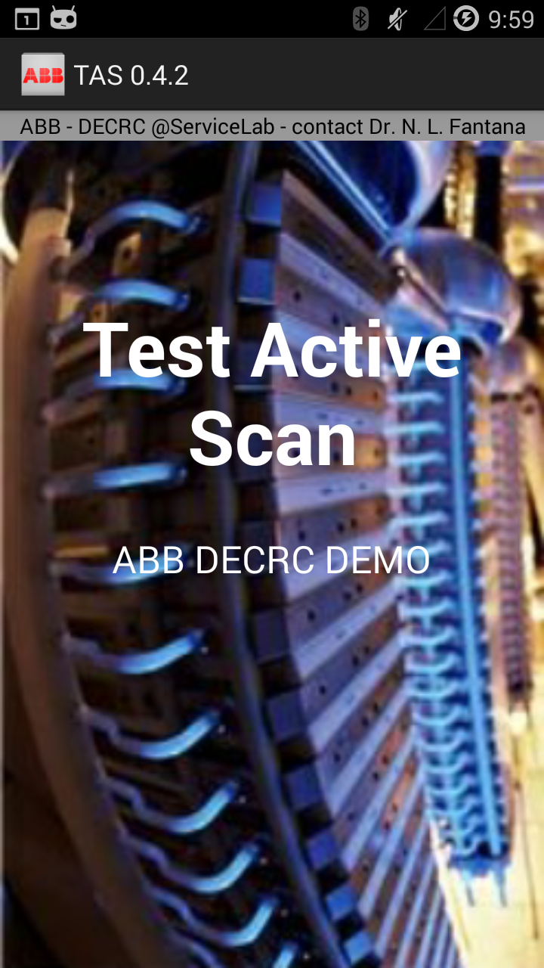
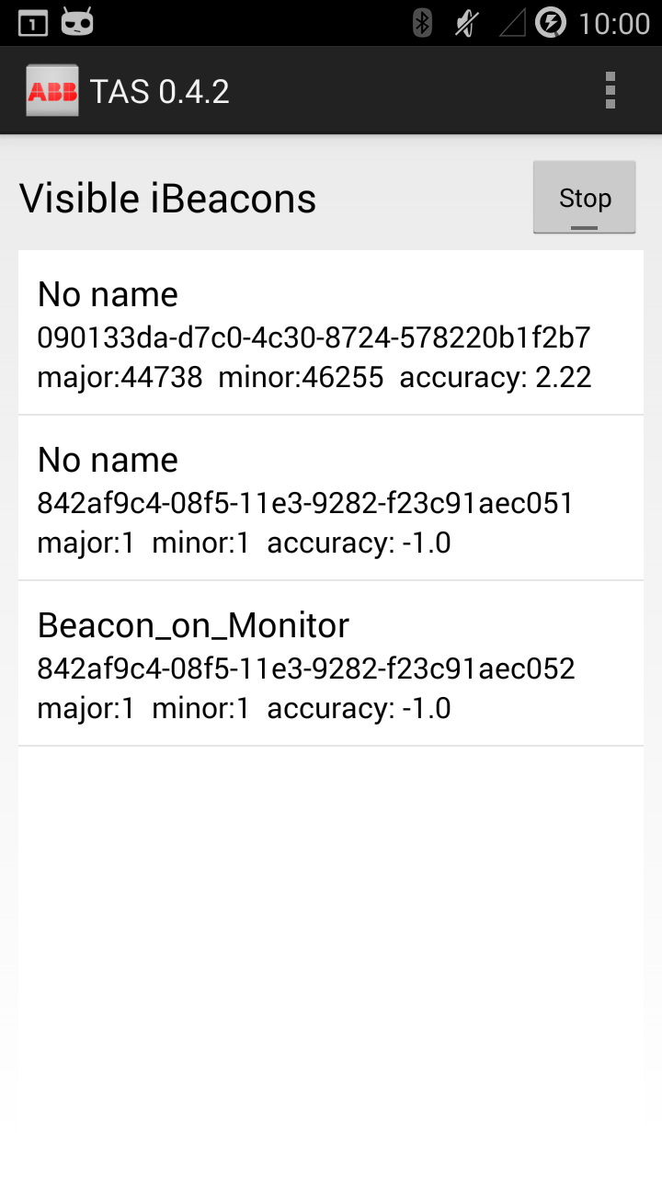
TAS 0.4.2

Slide 9
TAS 0.4.2
Features
Show found iBeacons in ListView
Show all files of iBeacon
Show content of files
Change name of iBeacon
Start/stop scanning

Slide 10
TAS 0.5.0
Features
Show found iBeacons in ListView
Show all files of iBeacon
Show content of files
Change name of iBeacon
Autostart/background mode

Slide 11
TAS 0.5.5
Features
Show found iBeacons in ListView
Show all files of iBeacon
Show content of files
Change name of iBeacon
Autostart/background mode
Create folder for contents if does not exist

Slide 12
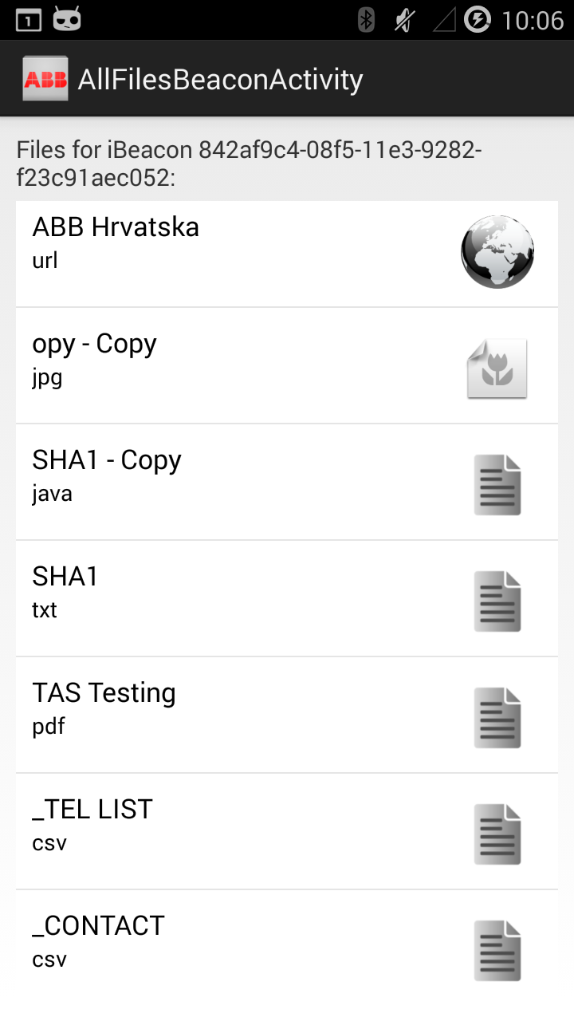
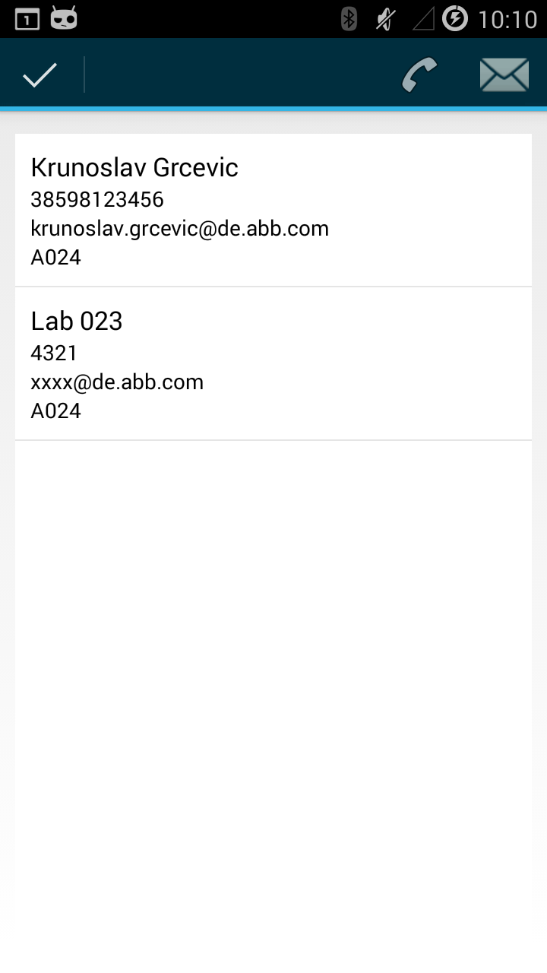
TAS 0.6.0

Slide 13
TAS 0.6.0
Features
Show found iBeacons in ListView
Show all files of iBeacon
Show content of files
Change name of iBeacon
Start/stop scanning
Phone list
Contact list

Slide 14
TAS 0.7.0

Slide 15
TAS 0.7.0
Features
Show found iBeacons in ListView
Show all files of iBeacon
Show content of files
Change name of iBeacon
Start/stop scanning
Phone list
Contact list
Show average of distance

Slide 16
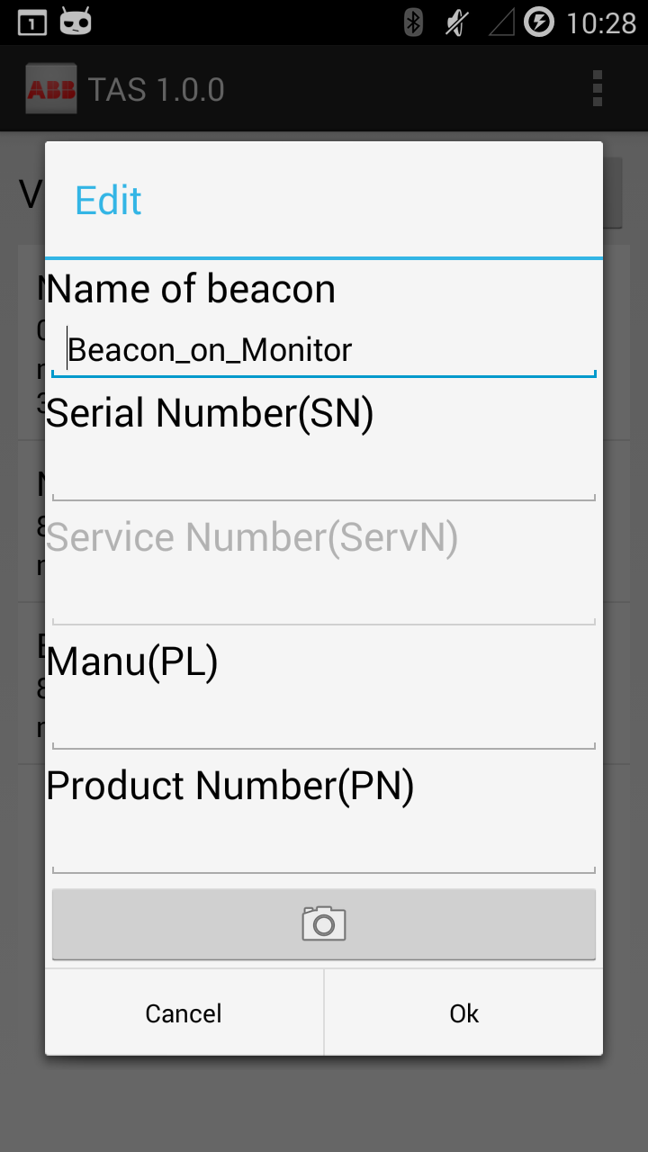
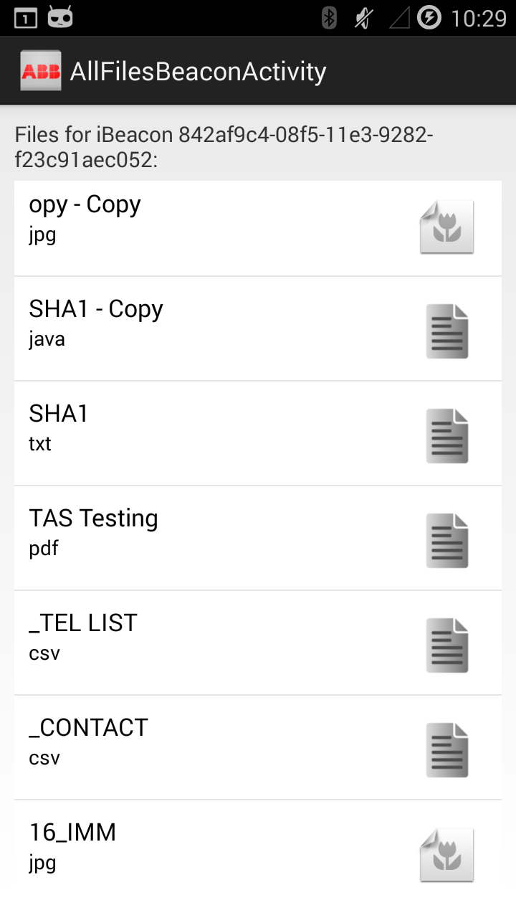
TAS 1.0.0

Slide 17
TAS 1.0.0
Features
Show found iBeacons in ListView
Show all files of iBeacon
Show content of files
Change name of iBeacon
Start/stop scanning
Phone list
Contact list
Distance categories
User can add contents

